Slide 1

Two Ways of Sharing Variables

Slide 2
Reference
Youtube on tf.get_variable
Youtube on tf.variable_scope
Youtube on Sharing Variables
Code

Slide 3
Fail to Share

Slide 4
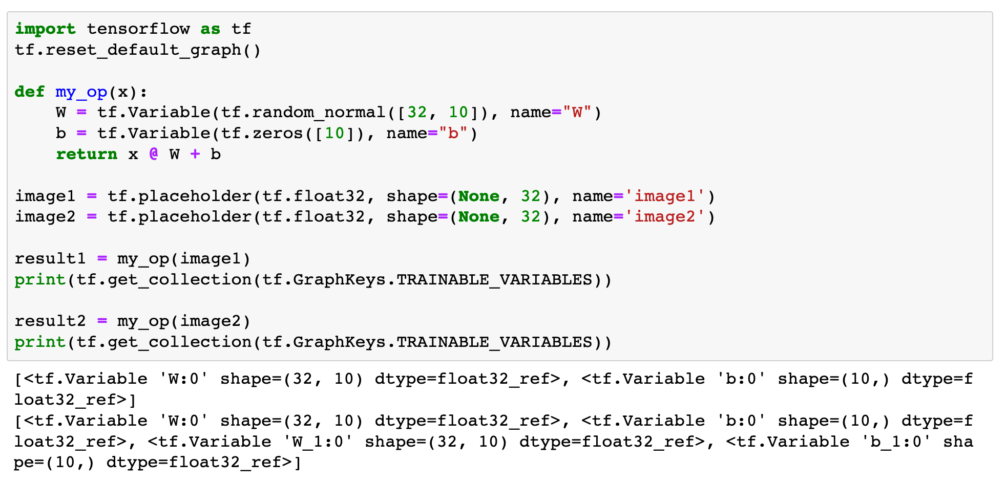


Slide 5
First Method - Dict

Slide 6
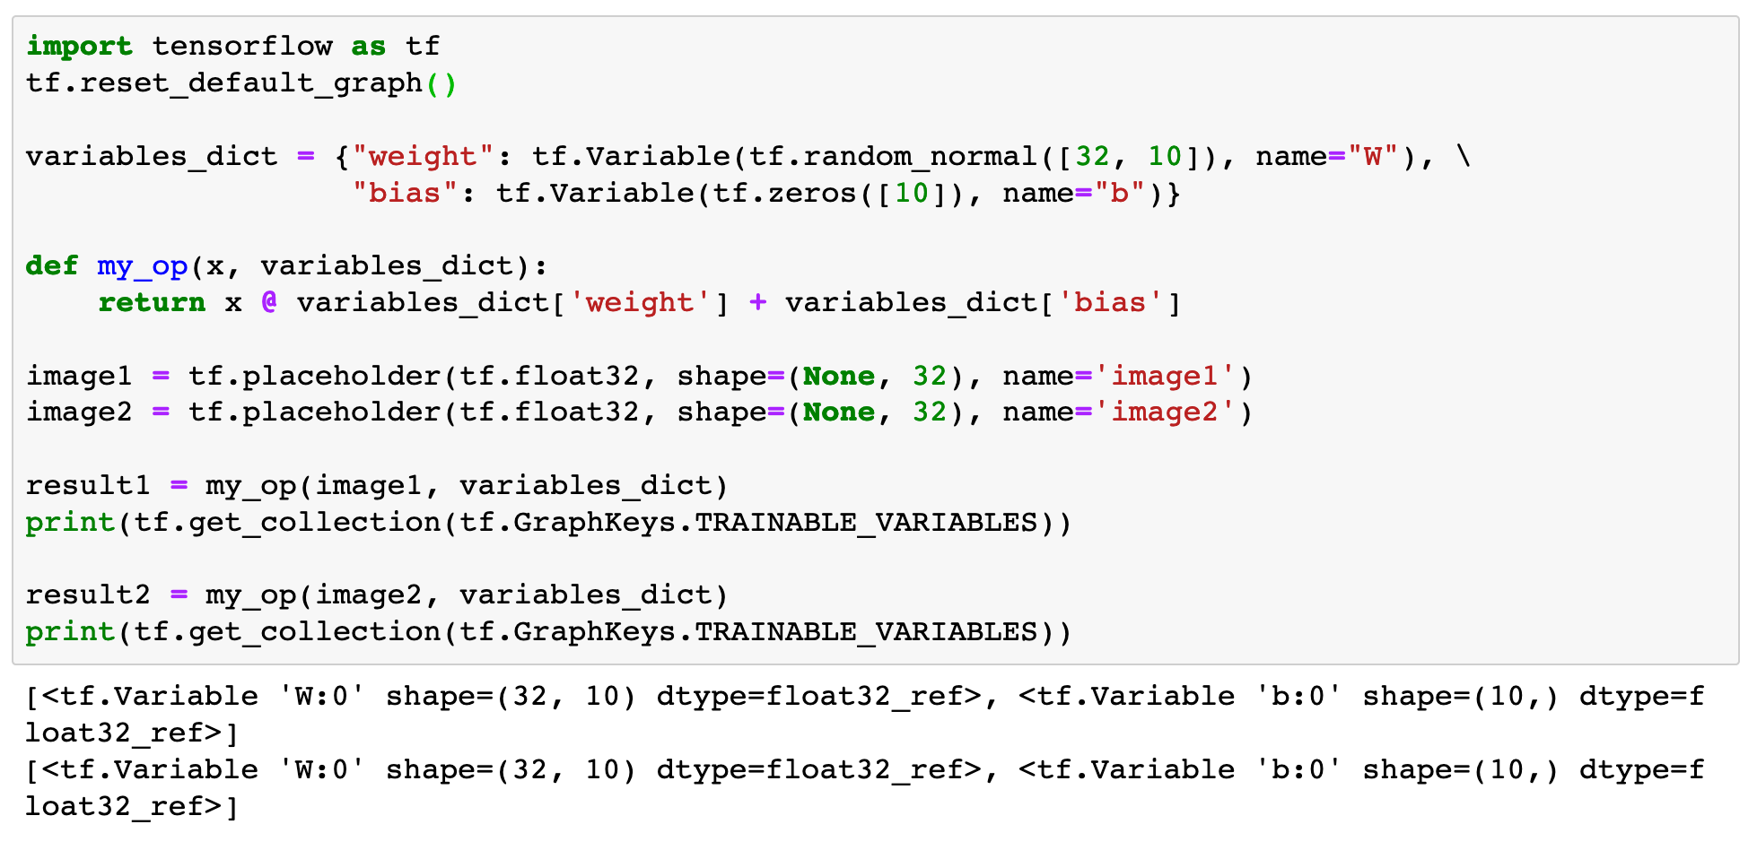

Slide 7
Second Method - tf.get_variable and tf.variable_scope

Slide 8
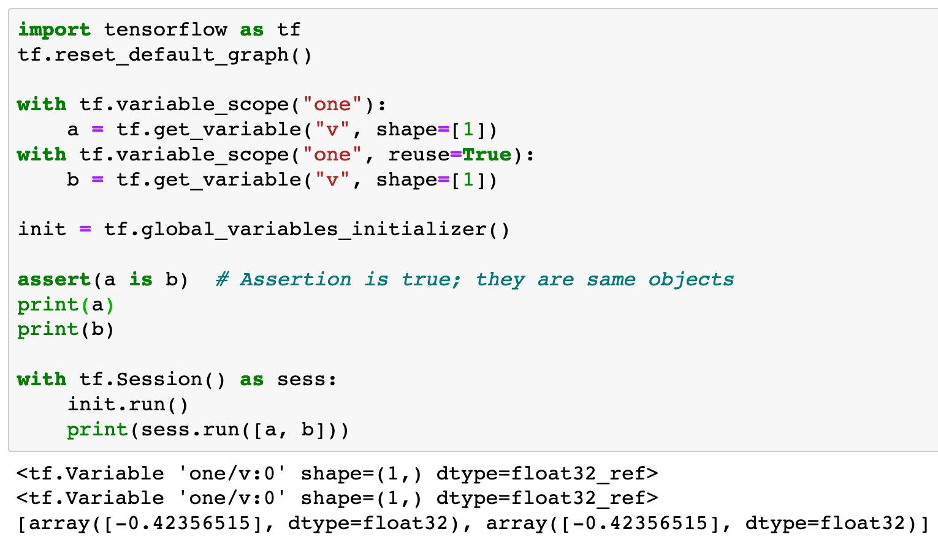

Slide 9
resue=True

Slide 10
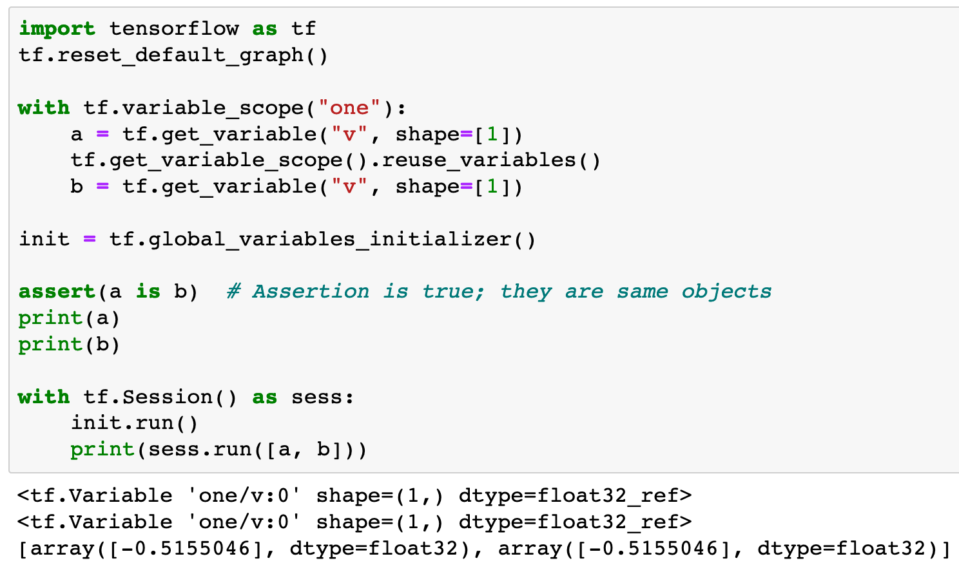

Slide 11
reuse variables
in the same variable scope

Slide 12
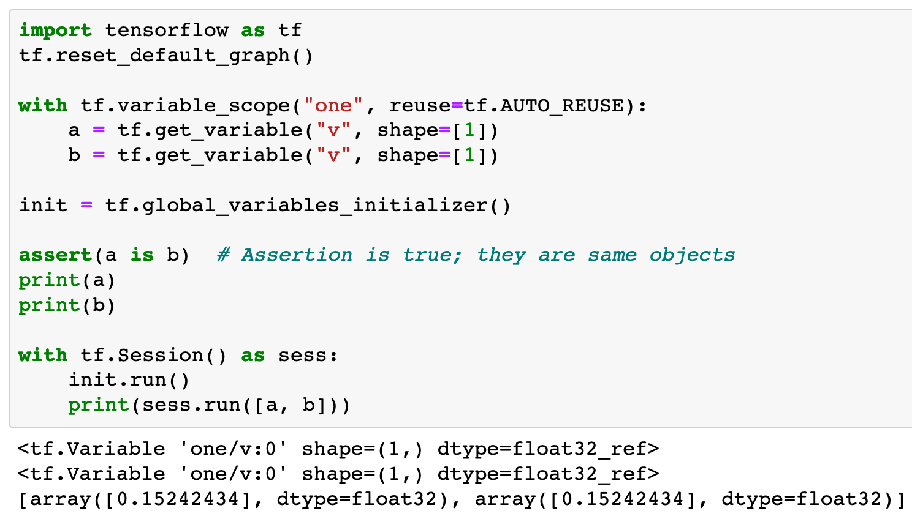

Slide 13
reuse variables
in the same variable scope
automatically

Slide 14
Now
Let’s Play with Code

